Slide 1
NETWORKING BASICS
IICT
ANOUD ABDULLAH

Slide 2
What is a computer network?
A computer network is a group of two or more interconnected computer systems.
You can establish a network connection using either cable or wireless media.
Every network involves hardware and software that connects computers and tools.

Slide 3
Advantages of a computer network
Helps you to connect with multiple computers together to send and receive information when accessing the network.
Helps you to share printers, scanners, and email.
Helps you to share information at very fast speed.
Electronic communication is more efficient and less expensive than without the network.

Slide 4
components of computer network
The essential computer network components:
Switches
Routers
Servers
Clients
Transmission Media
Access Points
Shared Data
Network Interface Card
Local OS
Networking OS
Protocol
Hub
LAN Cable
OSI

Slide 5
1. switches
Switches work as a controller which connects computers, printers, and other hardware devices to a network in a campus or a building.
It allows devices on your network to communicate with each other, as well as with other networks. It helps you to share resources and reduce the costing of any organization.

Slide 6
2. routers
Routers help you to connect with multiple networks. It enables you to share a single internet connection with multiple devices and saves money.
This networking component acts as a dispatcher, which allows you to analyze data sent across a network.
It automatically selects the best route for data to travel and send it on its way.

Slide 7
3. servers
Servers are computers that hold shared programs, files, and the network operating system.
Servers allow access to network resources to all the users of the network.

Slide 8
4. clients
Clients are computer devices which access and uses the network as well as shares network resources.
They are also users of the network, as they can send and receive requests from the server.

Slide 9
5. TRANSMISSION MEDIA
Transmission media is a carrier used to interconnect computers in a network, such as coaxial cable, twisted-pair wire, and optical fiber cable.
It is also known as links, channels, or lines.

Slide 10
6. ACCESS POINTS
Access points allow devices to connect to the wireless network without cables.
A wireless network allows you to bring new devices and provides flexible support to mobile users.

Slide 11
7. SHARED DATA
Shared data are data which is shared between the clients such as data files, printer access programs, and email.

Slide 12
8. NETWROK INTERFACE CARD
Network Interface card sends, receives data, and controls data flow between the computer and the network.

Slide 13
9. Local operating system
A local OS which helps personal computers to access files, print to a local printer and uses one or more disk and CD drives which are located on the computer.

Slide 14
10. Networking os
The network operating system is a program which runs on computers and servers.
It allows the computers to communicate via network.

Slide 15
11. protocol
A protocol is the set of defined rules that allows two entities to communicate across the network.
Some standard protocols used for this purpose are IP, TCP, UDP, FTP, etc.

Slide 16
12. hub
Hub is a device that splits network connection into multiple computers. It acts a distribution center so whenever a computer requests any information from a computer or from the network it sends the request to the hub through a cable. The hub will receive the request and transmit it to the entire network.

Slide 17
13. Lan cable
Local Area Network(LAN) cable is also called as Ethernet or data cable.
It is used for connecting a device to the internet.

Slide 18
14. osi
OSI stands for Open Systems Interconnection.
It is a reference model which allows you to specify standards for communications.

Slide 19
COMPUTER NETWORK TOPOLOGIES

Slide 20
NETWORK TOPOLOGY
Geometric representation of how the computers are connected to each other is known as topology.
There are five types of topology – Mesh, Star, Bus, Ring and Hybrid.

Slide 21
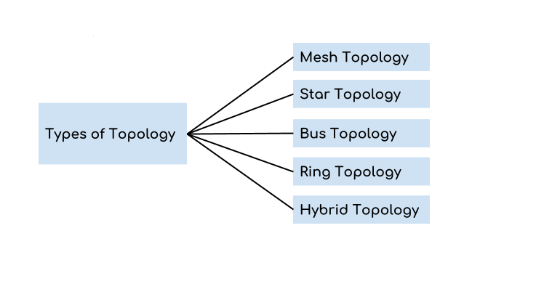
TYPES OF TOPOLOGY

Slide 22
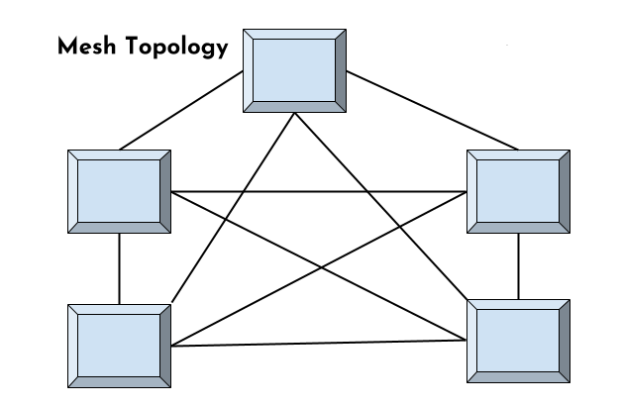
MESH TOPOLOGY

Slide 23
MESH TOPOLOGY
In mesh topology each device is connected to every other device on the network through a dedicated point-to-point link.
Dedicated means - that the link only carries data for the two connected devices only.
Lets say there are n devices in the network then each device must be connected with (n-1) devices of the network.
Number of links in a mesh topology of n devices would be n(n-1)/2.

Slide 24
Advantages:
No data traffic issues as there is a dedicated link between two devices which means the link is only available for those two devices.
Mesh topology is reliable and robust as failure of one link doesn’t affect other links and the communication between other devices on the network.
Mesh topology is secure because there is a point to point link thus unauthorized access is not possible.
Fault detection is easy.

Slide 25
Disadvantages:
Amount of wires required to connected each system is tedious and headache.
Since each device needs to be connected with other devices, number of I/O ports required must be huge.
Scalability issues because a device cannot be connected with large number of devices with a dedicated point to point link.

Slide 26
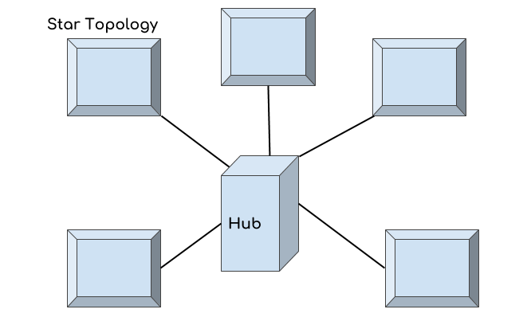
STAR TOPOLOGY

Slide 27
STAR TOPOLOGY
In star topology each device in the network is connected to a central device called hub.
Unlike Mesh topology, star topology doesn’t allow direct communication between devices, a device must have to communicate through hub.
If one device wants to send data to other device, it has to first send the data to hub and then the hub transmit that data to the designated device.

Slide 28
ADVANTAGES
Less expensive because each device only need one I/O port and needs to be connected with hub with one link.
Easier to install
Less amount of cables required because each device needs to be connected with the hub only.
Robust, if one link fails, other links will work just fine.
Easy fault detection because the link can be easily identified.

Slide 29
DISADVANTAGES
If hub goes down everything goes down, none of the devices can work without hub.
Hub requires more resources and regular maintenance because it is the central system of star topology.

Slide 30
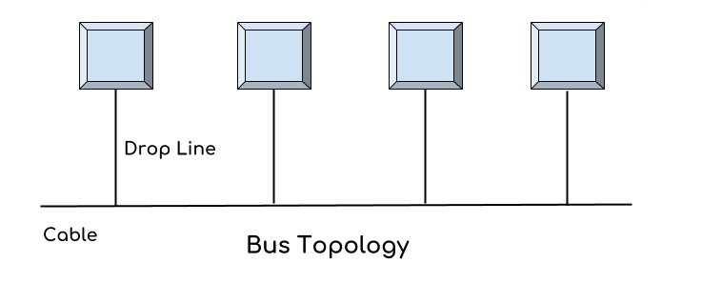
BUS TOPOLOGY

Slide 31
BUS TOPOLOGY
In bus topology there is a main cable and all the devices are connected to this main cable through drop lines.
There is a device called tap that connects the drop line to the main cable.
Since all the data is transmitted over the main cable, there is a limit of drop lines and the distance a main cable can have.

Slide 32
ADVANTAGES
Easy installation, each cable needs to be connected with backbone cable.
Less cables required than Mesh and star topology

Slide 33
DISADVANTAGES
Difficultly in fault detection.
Not scalable as there is a limit of how many nodes you can connect with backbone cable.

Slide 34
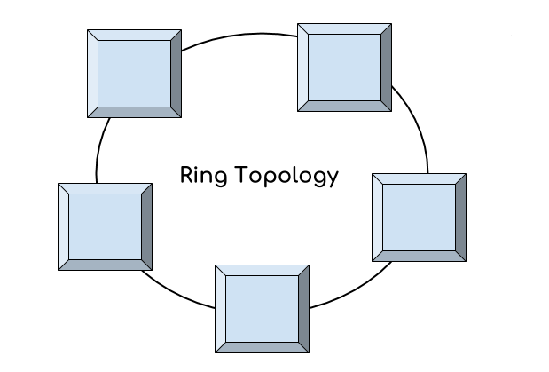
RING TOPOLOGY

Slide 35
RING TOPOLOGY
In ring topology each device is connected with the two devices on either side of it.
There are two dedicated point to point links a device has with the devices on the either side of it.
This structure forms a ring thus it is known as ring topology.
If a device wants to send data to another device then it sends the data in one direction, each device in ring topology has a repeater, if the received data is intended for other device then repeater forwards this data until the intended device receives it.

Slide 36
ADVANTAGES
Easy to install.
Managing is easier as to add or remove a device from the topology only two links are required to be changed.

Slide 37
DISADVANTAGES
A link failure can fail the entire network as the signal will not travel forward due to failure.
Data traffic issues, since all the data is circulating in a ring.

Slide 38
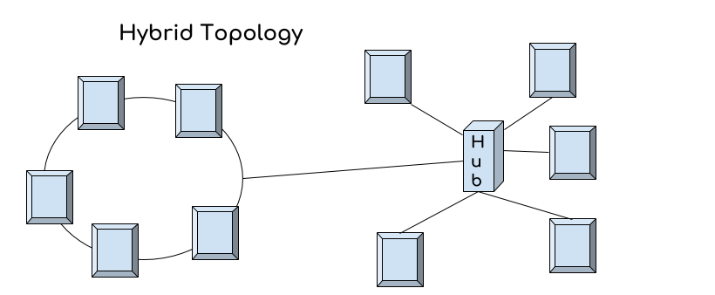
HYBRID TOPOLOGY

Slide 39
HYBRID TOPOLOGY
A combination of two or more topology is known as hybrid topology.
For example a combination of star and mesh topology is known as hybrid topology.

Slide 40
ADVANTAGES
We can choose the topology based on the requirement for example, scalability is our concern then we can use star topology instead of bus technology.
Scalable as we can further connect other computer networks with the existing networks with different topologies.

Slide 41
DISADVANTAGES
Fault detection is difficult.
Installation is difficult.
Design is complex so maintenance is high thus expensive.

